Slide 1
Micro-project
[BCC]-Basic Communication using Computer
By: MS. Nagma Khan

Slide 2
PARTICIPANTS
210448 – HUSSAIN ARSIWALA
210449 – VINAYAK KARANDE
210450 – ADNAN SHAIKH
210451 – ABDURRAHMAN QURESHI
210452 – HAFSA WELDER

Slide 3


TOPIC
Comparative study of Bio Data, Resume and Curriculum Vitae.

Slide 4
BIO-DATA

Slide 5
What is Biodata?
Also known as biographical data, a biodata typically includes a range of specific factual information about an individual. Essentially, biodata highlights a number of details about a person such as: name, age, color, height, skills, hobbies, allergies etc.

Slide 6

IMPORTANCE OF BIO DATA
It is important to know the kinds of information that are required with each type of biodata. This way, you will know what information to provide and what not to provide when you are asked to fill in any type of biodata.

Slide 7
USE
You can use biodata format when your job needs only your basic details, and whenever you don’t have time to prepare a resume then you can just take the printout of the biodata and write down your details.

Slide 8
FORMAT
There is no fixed format for biodata, you can be creative in making your biodata format but always keep it simple and shorter. It is better to adjust your information to fit in 1 page of biodata format. If it is not possible to adjust then you can add another page.

Slide 9
TYPES
There are 5 types of Bio-Data:
Job
Personal
Educational
Medical
Marriage

Slide 10
Personal
What is Personal Bio-Data?
Examples
Personal biodata refers to a range of personal details or information about an individual. These pieces of information are key to profiling the individual in question. It is not unusual for personal biodata to be requested when you are completing certain applications.
Examples of personal biodata include but are not limited to: Name, Age, Date of Birth, Gender, Contact Information, Height, Occupation, Weight, Marital Status, Religion, and the State of Residence you are completing certain applications.

Slide 11
Job Bio-Data
What is Job Bio-Data?
Examples
A job or employment biodata is a set of information with regards to an individual's professional competencies and skills. It usually highlights the professional experiences of a person with regard to a specific job role.
Examples of job biodata include name, contact information, educational background, work history, skills, interests, awards, certifications, and professional qualification(s).

Slide 12
Educational Bio-Data
Educational biodata refers to information about a person's education. It profiles the educational qualification and background of an individual.
Educational biodata can be subdivided into two parts. These are; Student and Teacher biodata.

Slide 13
Teacher
Student
Teacher's educational biodata refers to information about the educational qualification and experiences of an individual.
Examples of teacher's educational biodata include name, educational qualification, certifications, awards, work experience.
Student's educational biodata refers to information about a student. It reflects the student's level of education.
Examples of student's educational biodata include name, age, the highest level of education, grades, educational certifications, department, and faculty

Slide 14
Medical Bio-Data
What is Medical Bio-Data?
Examples
Medical biodata refers to the medical information about an individual. Medical biodata may be requested as part of educational or recruitment criteria.
Many schools require prospective candidates to provide medical biodata before admission.
Examples of medical biodata include blood group, genotype, rhesus factor, information on disability, information on allergies, information on health conditions like asthma and ulcer.
It is important for you to provide accurate information with regard to your medical biodata.

Slide 15
CURRICULUM VITEA

Slide 16
What Is a Curriculum Vitae?
A curriculum vitae is an exhaustive listing of all of the significant achievements in your career. This includes education, research, work experience, publications, presentations, and anything else you’ve done in your professional life. Think of a CV as a complete account of everything that qualifies you as an expert in your field, Good fellow says.
If you’ve only ever made a resume, you’re probably used to cutting down your skills, experience, and education to one page—or in rare cases two pages. That’s because you’re trying to focus on only the things that are most relevant to the job you’re applying to.

Slide 17
How to write a CV...

Slide 18


But how do we create one properly?

Slide 19
Steps To Write A CV
Contact information
Academic history
Professional experience
Qualifications and skills
Awards and honors
Personal information (Optional)
Publications
Professional associations
Grants and fellowships
Licenses and certificates
Volunteer work
Hobbies and interests (Optional)

Slide 20
How Long Should a CV Be?
A good, entry-level curriculum vitae should ideally cover two to three pages (CVs for mid-level professionals, especially in academia and medical research roles, may run longer).
Aim to ensure the content is clear, structured, concise, and relevant. Using bullet points rather than full sentences can help minimize word usage.

Slide 21
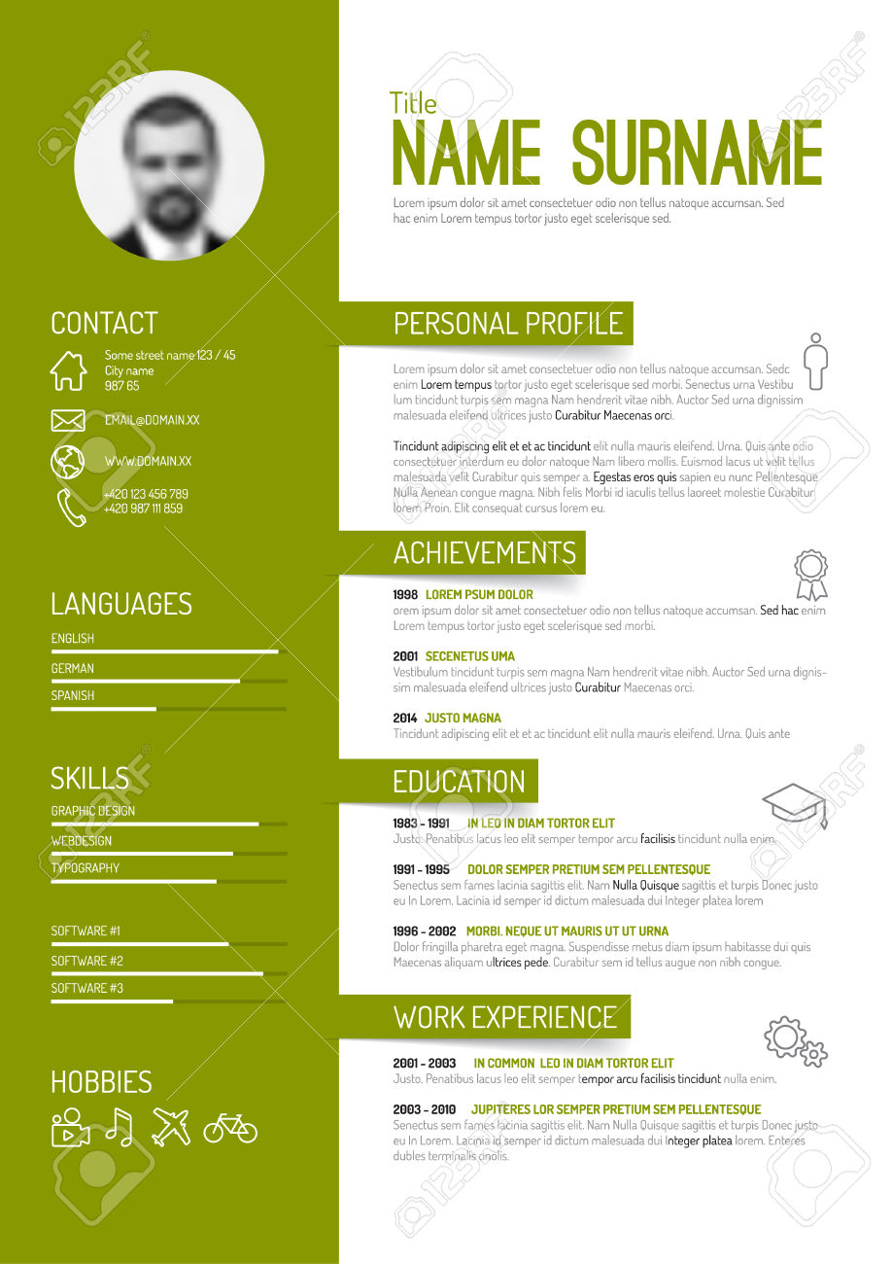
Curriculum Vitae Sample

Slide 22
Importance of Resume
The resume acts as a bridge between you and the prospective recruiter. Hence the importance of a resume can never be underestimated. So, to make the first impression, it is imperative that your resume stands out from the crowd first. It is up to you how do you want to be remembered by the hiring manager?

Slide 23
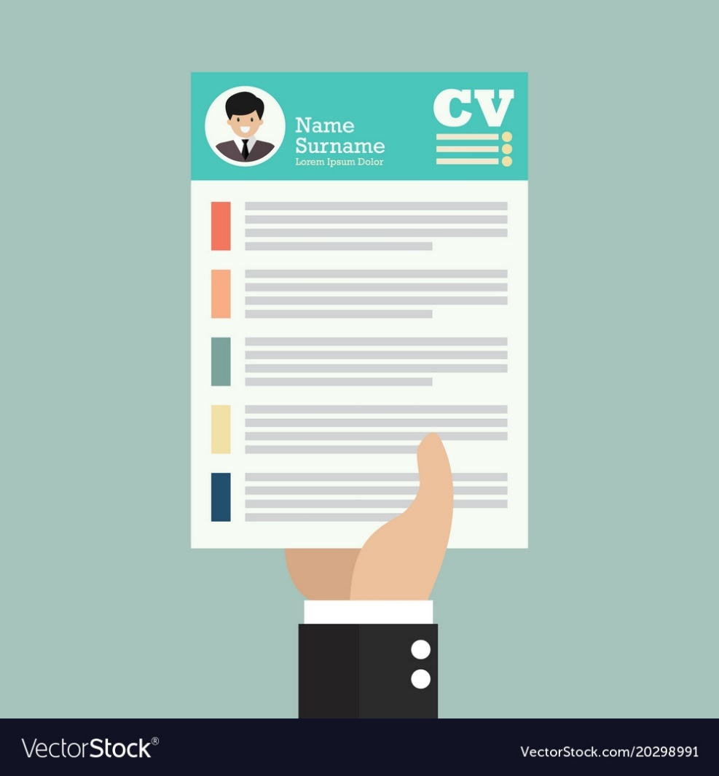
Since companies do not have that much amount of time to interview each and every candidate, they require resumes from candidate to select the best ones to work with them.

Slide 24
RESUME

Slide 25

What is a Resume?
A resume is a formal document that a job applicant creates to itemize their qualifications for a position. A resume is usually accompanied by a customized cover letter in which the applicant expresses an interest in a specific job or company and draws attention to the most relevant specifics on the resume.

Slide 26
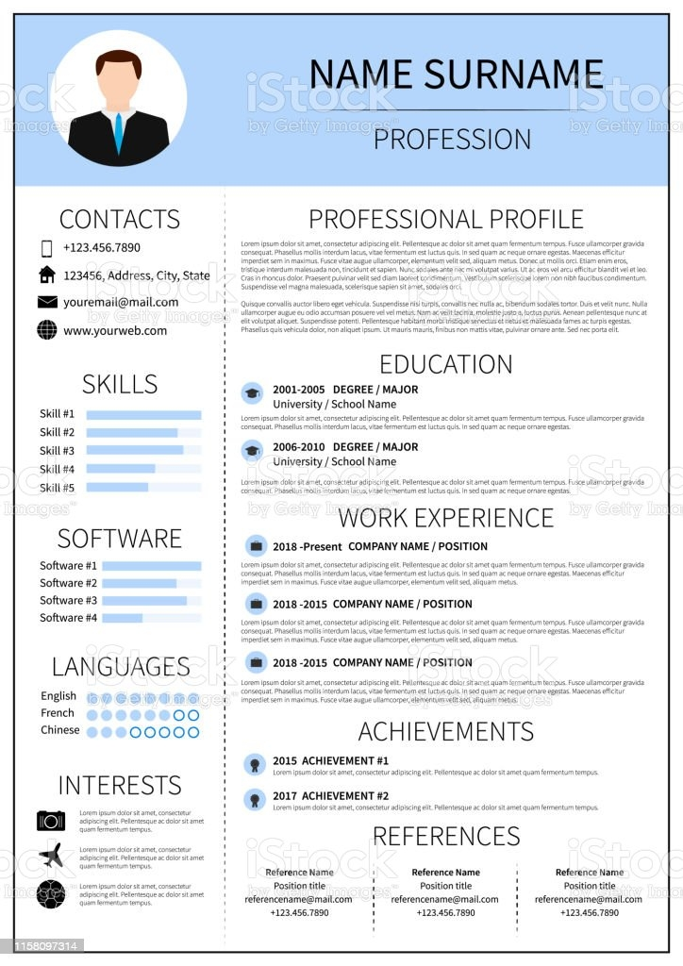
Goal Of a Resume
The goal and overall purpose of a resume is to introduce your qualifications and skills to employers. It's an informational document that tells your career story, outlining all details in an easily read format. Resumes also hold meaning within themselves.

Slide 27

Format of resume :
•Personal Details:
Name
Date of birth
Address
Contact number
Email id
Caste
•Objective
Educational Qualification
Extra Curriculum Activities
Declaration

Slide 28
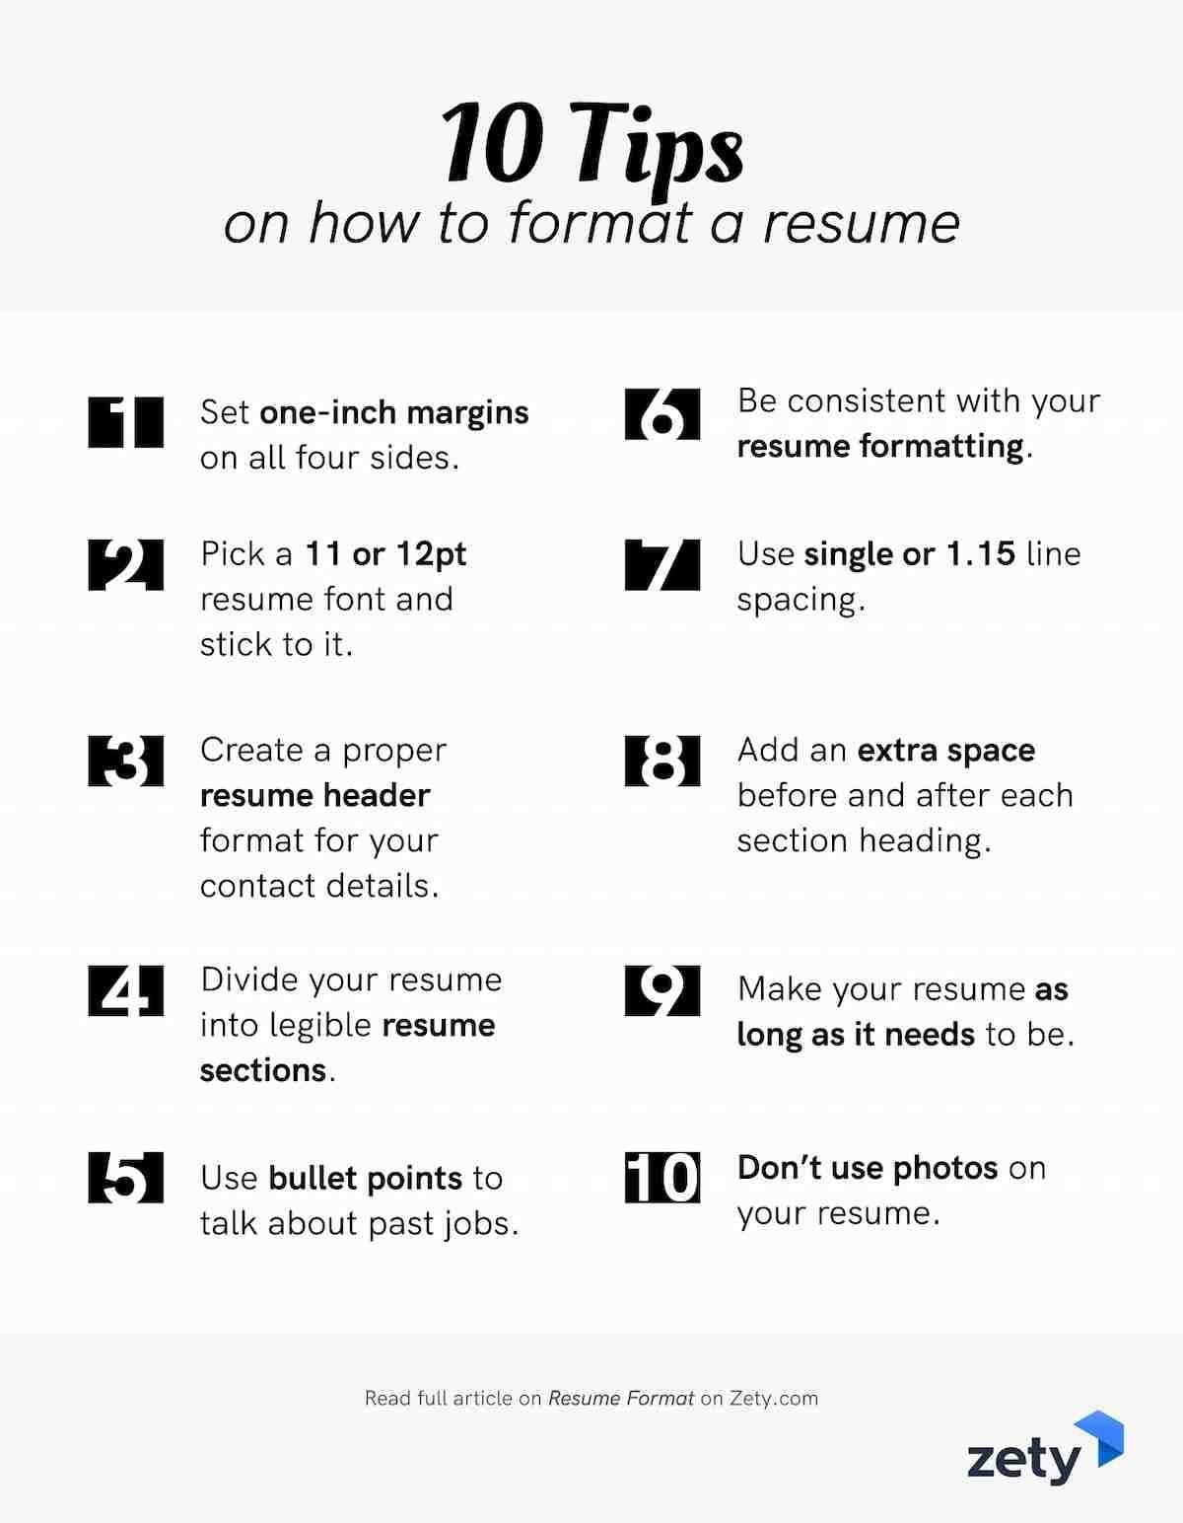
Few tips for a resume

Slide 29
Do’s & Don’ts of Resume Writing

Slide 30

DO’s
Determine your job search objective prior to writing the resume and tailor your resume for the position.
Customize your resume to match a specific job description. Use buzzwords from the industry.
Focus on positive results and accomplishments. Keep a consistent, easily-readable format.
Create strong, action-oriented statements about your work.

Slide 31

DONT’S
Use templates and tables included in software. Make general claims (“Good communication skills”) without backing them up with examples.
Mislead employers about your GPA, skills, or abilities. Include long, generic objective statements.
Employers won’t read them! Submit references on the same page as your resume.
They should be kept in a separate document and provided when the employer asks for them.

